Slide 1



Operational Energy System of Systems Evaluation
Final Presentation
5 June 2013
Presented by:
Bill Berklich Christine Brennan
Steve Mazza Dan Torres

Slide 2
AGENDA
Introduction
Initial Research Questions
Literature Review
Questions Addressed
OE Characteristics
Conclusions

Slide 3
INTRODUCTION
The United States possesses a military that requires capabilities provided by the integration of many systems, across many functional areas, and yet develops those systems in a stovepipe.
It is critical to begin assessing, developing, integrating and governing these capabilities from a system of systems perspective to enable the evaluation of an operational capability as opposed to a single system.
If the Army were to begin treating operational energy as a system, it would be possible to better understand the true implications of a system in terms of capability of the system of systems, as well as begin to identify where the greatest ROI would be for development.

Slide 4
What is Operational Energy?
Operational Energy is defined as the “energy required for training, moving, and sustaining military forces and weapons platforms for military operations. The term includes energy used by tactical power systems and generators and weapons platforms.”
Three Consumers: Soldier, Vehicles, Bases
This is one of the largest systems of systems in existence.
“In 2010, U.S. armed forces consumed more than five billion gallons of fuel in military operations. The number one factor driving that fuel consumption is the nature of today’s defense mission.” – OE Strategy
Notes:
Operational Energy is defined as the “energy required for training, moving, and sustaining military forces and weapons platforms for military operations. The term includes energy used by tactical power systems and generators and weapons platforms.”
Three Consumers: Soldier, Vehicles, Bases
This is one of the largest systems of systems in existence. It is the evaluation of all of the systems that are included in soldiers, vehicles, and bases that not only consume energy but also those that drive energy consumption.
In order to assess the full impact that a system has on the overall energy capability of the Army, it is imperative to determine the interdependencies and relationships that exist within the greater system of systems view.

Slide 5
Scope of the Case Study
In order to assess the full impact that a system has on the overall energy capability of the Army, it is imperative to determine the interdependencies and relationships that exist within the greater system of systems view.
OE strategy focuses a lot on energy security and economy. However, due to the timeline available, the team will be focusing on evaluating the section of Operational Energy that centers on the distribution of supplies within an area of operations (AOR).
How do supplies get moved from base to base? How do they get moved from base to fight? How do they get planned? How do they get prepared? How do they get distributed?

Slide 6
Scope of the Case Study
Some of the systems included in this SoS are:
Transportation Equipment
Air
Ground
Networks
Protection Convoys
Distribution Hubs (Bases)
Soldier as a System (SaaS)
Some of the supplies being moved are: Fuel, Water, Waste, Medical, Personnel, Cargo

Slide 7
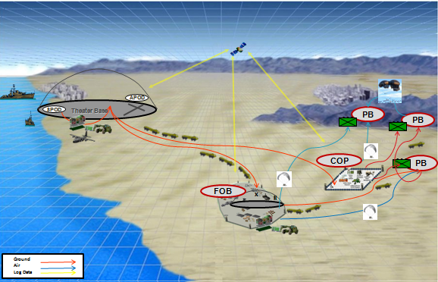
OV- 1 Distribution

Slide 8
INITIAL RESEARCH QUESTIONS
What is encompassed in the system of systems for the distribution system for operational energy?
What current capability gaps exist with respect to operational energy distribution?
How would the operational energy distribution system be categorized in terms of System of Systems (SoS)?
What are the benefits and consequences of evaluating and treating operational energy distribution as a system of systems?
What are the consequences of not addressing operational energy distribution as an SoS?
What are the challenges to treating this as a system of systems, both technically and programmatically? What Program Executive Organizations (PEOs) and what other organizations are involved?
Notes:
What is encompassed in the system of systems for the distribution system for operational energy?
A proper assessment of operational energy distribution must begin with identification of the constituent systems that power DoD installations and platforms and their relationships.
What current capability gaps exist with respect to operational energy distribution?
The distribution system’s activities and functions require evaluation for inefficiencies, and threats to energy security. In some instances, the identification of a “gap” may need to be composed without supporting requirements or explicit statements of capability needs. In those cases, documentation must be cited to support the statement of the capability gap.
How would the operational energy distribution system be categorized in terms of System of Systems (SoS)?
There is widespread agreement that SoS can be characterized along a continuum running between 1) virtual, 2) collaborative, 3) acknowledged, and 4) directed. Recent work in the field of SoS has defined five characteristics for assessing an SoS, these include autonomy, belonging, connectivity, diversity, and emergence. The recent research establishes patterns of SoS’ success relative to the assessment of those five characteristics in the context of the manner in which a particular SoS is governed.
What are the benefits and consequences of evaluating and treating operational energy distribution as a system of systems?
With this particular problem, it could be stated that there is an inversion in the architecture viewpoint compared to traditional assessment. For conventional platforms and installations, the flows of energy would traditionally be viewed as inputs and outputs to the primary system functions and the physical instantiations of systems and sub-systems. To put this SoS in proper context, it may be more appropriate to consider the sources and sinks/stores of energy as the primary SoS constituent system elements and the platforms and sites that are powered through that energy as outputs of the process.
What are the consequences of not addressing operational energy distribution as an SoS?
Presumably the DoD would stand a lesser chance of achieving operational energy goals without the focus that an SoS consideration and viewpoint provides. Specifically, what risks are inherent if an ad-hoc operational energy management approach is used when forecasting potentially unstable energy supply lines and sources of generation, and price volatility? Also, if potentially increasing portions of budget are allocated to operational energy distribution what needed capabilities or operational readiness are reduced in that scenario? The recent land based conflicts U.S. armed forces have been involved with may not provide an accurate picture of operational energy distribution costs and logistics for potential future theaters of operation.
What are the challenges to treating this as a system of systems, both technically and programmatically? What Program Executive Organizations (PEOs) and what other organizations are involved?
The challenges regarding system development across domains presents a unique technical challenge in terms of interfaces, standardization and integration. However, aside from the technical challenges there are major concerns with the implementation of a governance structure that will abide by the necessary laws and statutes while providing the required oversight and authority to enforce the system of systems methodology. Many challenges that may arise revolve around the perceived infringement of current tasks, dollars and responsibilities. Thus the need to focus heavily on the governance implementation, especially for the SoS programs being implemented post-development and deployment (ie Operational Energy).

Slide 9
LITERATURE REVIEW
Energy for the Warfighter: Operational Energy Strategy
This paper lays out a plan for operational energy that places an emphasis on energy security. Energy security is characterized by guaranteed access sufficient energy and the ability to safely deliver enough energy to sustain operations. Furthermore, this paper introduces an Assistant Secretary of Defense for Operational Energy Plans and Programs.
The Value Of Energy Security From the Battlefield To the Base
Presented as an address to the House Armed Services Committee during the Second Session of the 112th Congress of the United States, a broad description was laid out for increased efficiency and a greater emphasis on renewable energy. The principal problem was identified as an over-reliance on fossil fuels and characterized by high cost, high risk to security, and high environmental impact.
Operational Energy Metrics: Increasing Flexibility While Reducing Vulnerability
Fully burdened fuel cost was calculated and took into account energy reduction (efficiency), cost of moving energy (transportation), streamlining acquisition, and the impact to operational effectiveness. The overall goals were to increase flexibility and reduce cost by focusing on acquisition and force structure.
Analysis of Policy and Guidance Regarding Sustainability
With a focus on sustainability, this source focused on existing policy and doctrine supporting both sustainability and environmental considerations and attempted to link these to contingency operations. This source was unique in the emphasis that it places on environmental concerns, acknowledging the link between environmental impact and sustainable energy operations.
Notes:
Energy for the Warfighter: Operational Energy Strategy
This paper lays out a plan for operational energy that places an emphasis on energy security. Energy security is characterized by guaranteed access sufficient energy and the ability to safely deliver enough energy to sustain operations. Furthermore, this paper introduces an Assistant Secretary of Defense for Operational Energy Plans and Programs.
The Value Of Energy Security From the Battlefield To the Base
Presented as an address to the House Armed Services Committee during the Second Session of the 112th Congress of the United States, a broad description was laid out for increased efficiency and a greater emphasis on renewable energy. The principal problem was identified as an over-reliance on fossil fuels and characterized by high cost, high risk to security, and high environmental impact.
Operational Energy Metrics: Increasing Flexibility While Reducing Vulnerability
Fully burdened fuel cost was calculated and took into account energy reduction (efficiency), cost of moving energy (transportation), streamlining acquisition, and the impact to operational effectiveness. The overall goals were to increase flexibility and reduce cost by focusing on acquisition and force structure.
Analysis of Policy and Guidance Regarding Sustainability
With a focus on sustainability, this source focused on existing policy and doctrine supporting both sustainability and environmental considerations and attempted to link these to contingency operations. This source was unique in the emphasis that it places on environmental concerns, acknowledging the link between environmental impact and sustainable energy operations.

Slide 10
RESEARCH QUESTIONS ADDRESSED
Due to the constraints of time available and the resources, only two of the six research questions were evaluated. The two questions were chosen because of the benefit the SoS would have on them, as well as the merit to the assessment of the system.
What current capability gaps exist with respect to operational energy distribution?
What are the challenges to treating this as a system of systems, both technically and programmatically? What Program Executive Organizations (PEOs) and what other organizations are involved?

Slide 11
RESEARCH QUESTIONS ADDRESSED (CON’T)
What current capability gaps exist with respect to operational energy distribution?
Moving large volumes of fuel for military operations entails logistical and tactical risks and challenges, and it can also be costly.
FY 2007 in Iraq and Afghanistan, a total of more than 3,000 Army personnel and contractors were wounded or killed in action from attacks on fuel and water resupply convoys.
According to USTRANSCOM, air delivery is 10 times as expensive as ground delivery.
Department currently lacks sufficient data on and analysis of operational energy use to manage consumption effectively
Current patterns of national and military energy supply, specifically of oil, carry strategic consequences ranging from effects of procuring and moving large volumes of fuel through a theater of operations to the geopolitical effects of growing global demand for oil, increasing concentration of supplies, and damaging the environment
Current energy infrastructure remains vulnerable to disruption from hazards, including weather, natural disasters, human error, maintenance shortfalls, equipment failures, and attacks on infrastructure, including cyber attacks
By the end of 2010, DLA-Energy was moving 40 million gallons of fuel per month into Afghanistan alone.

Slide 12
RESEARCH QUESTIONS ADDRESSED (CON’T)
As stated, some information is available, but governance of the system of systems that delivers the operational energy distribution capability requires better data
The security and vulnerability of the logistical convoys delivering the operational energy
The capability to generate energy locally at the forward-most bases will also enhance security through a reduction in the number of convoys in the most dangerous of areas
The data exemplified how solutions to improving the distribution efficiency can be on bases or in the combat vehicles, not necessarily in the distribution system, thus the importance of SoS evaluations

Slide 13
RESEARCH QUESTIONS ADDRESSED (CON’T)
What are the challenges to treating this as a system of systems, both technically and programmatically? What Program Executive Organizations (PEOs) and what other organizations are involved?
One current effort being lead by PEO CS&CSS through the Joint Operational Energy Initiative (JOEI) which is looking to evaluate the overall impacts to a theatres energy supply and demand, and if given solutions can impact that energy delta.
The current efforts is in beta form to develop a toolset and methodology by which existing and proposed technologies can be evaluated to determine the impact or benefit to the Army, in terms of energy concerns.
Not recommending the Army’s distribution system be managed as a SoS, but rather evaluated and provide a governance over it so that informed decisions can be made and implemented to benefit the overall Army
Notes:
The current efforts is in beta form and is focusing specifically on the distribution system but will be integrating with the contingency basing effort to utilize the loads from the bases as inputs. The major output of this project is to develop a toolset and methodology by which existing and proposed technologies can be evaluated to determine the impact or benefit to the Army, in terms of energy concerns.

Slide 14
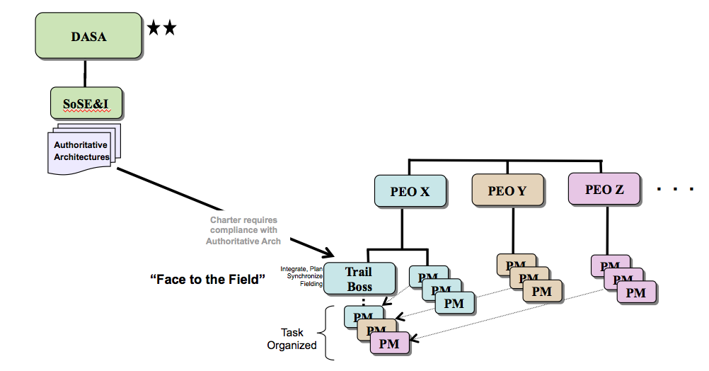
RESEARCH QUESTIONS ADDRESSED (CON’T)
Contingency Basing Proposed structure by CBDPT 2011

Slide 15
RESEARCH QUESTIONS ADDRESSED (CON’T)
Governance
SoSE&I
An authoritative architecture would need to be maintained at the highest level, above all of the PEOs that would have a stake in the SoS
Conflict resolution between interface touch points, sub-optimization decisions, direction of the SoS trades analysis and trade objectives and criteria

Slide 16
RESEARCH QUESTIONS ADDRESSED (CON’T)
Governance
PEO
Establish a “trail boss”, responsible for performing the individual evaluations and assessment within their given domain to provide recommendations to SoSE&I
The trail boss would have the responsibility to integrate platform level trades, define interfaces, boundaries and parameters among all the necessary players, optimize solution sets across involved platforms, develop the lower level architectures to be rolled up and managed by SoSE&I, and provide funding estimates for recommended integration efforts to be decided on by SoSE&I.
Most importantly this would provide the integrated analysis and recommendations for the path forward.

Slide 17
RESEARCH QUESTIONS ADDRESSED (CON’T)
Governance
PM
The individual PMs would remain responsible for the development and sustainment of the platforms within their portfolio.
Responsible for participating in a task organization with the trail boss to provide the necessary information and requirements to ensure that the capabilities of the overall mission are met, along with the necessary requirements for their given platforms.
Notes:
There are authorities in place to analyze the individual components at the system level and the system of system of level. The requirements that are not being met are then flowed down through the overarching architecture to determine what systems need to be improved or developed to meet that capability, while simultaneously tracking the implications of those changes. It would provide an overarching analysis to identify what potential DOTmLPF elements are impacted, what logistical elements are impacted and secondary benefits or burdens are incurred so they can be addressed early.

Slide 18
SYSTEM OF SYSTEMS CHARACTERISTICS

Slide 19
CHARACTERISTICS OF OE
System of Subsystems
System of Systems
Conformance
AUTONOMY
Independence
Centralization
BELONGING
Decentralization
Platform-Centric
CONNECTIVITY
Network-centric
Homogeneous
DIVERSITY
Heterogeneous
Foreseen
EMERGENCE
Indeterminable
Virtual

Slide 20
CHARACTERISTICS OF OE
System of Subsystems
System of Systems
Conformance
AUTONOMY
Independence
Operational Energy Distribution constituent systems are very Autonomous
The energy consuming organizations also operate autonomously
The units can operate in a very standardized fashion or in a more austere manner if at the edges of active AORs
The logistics organizations that are at the core of OE Distribution are given latitude to contract local service providers, or use organic capabilities (frequently a mix of both)
The energy consuming platforms are highly independent, with focus on operational mission
Establishment of an OE KPP for new systems would help to create recognition that performance, cost, RAM, and efficiency are all necessary values to consider/requirements to meet
Toward the Conforming extreme is possibly excessive standardization (tactical generators for example)

Slide 21
CHARACTERISTICS OF OE
System of Subsystems
System of Systems
Centralization
BELONGING
Decentralization
The nature of the Decentralization for OE Distribution is such that FoS may be a better term to apply to this SoS
Legacy constituent systems have been developed over decades
Therefore many of the systems have been upgraded in order to serve a new mission/purpose or to serve in a new environment or changed threat level
Many of the recent upgrades have improved security
Priorities exist for supplies moved, each base Mayor and/or their chain of command may cause volatile changes to short term logistics plans
Many organizations have participated in composing requirements for these systems, typically viewed as support system elements
In that sense, the SoS for OE Distribution is already “not optimized” (assuming prime equipment interfaces have been prioritized in development)
A move toward more centralization should improve efficiency (at least oversight, if not management)

Slide 22
CHARACTERISTICS OF OE
System of Subsystems
System of Systems
Platform-Centric
CONNECTIVITY
Network-centric
The OE Distribution SoS is predominantly Network-centric
This characteristic provides context for assessing some OE Distribution inefficiencies
Some redundant capabilities, when needed, greatly increase cost and time to deliver needed supplies compared to the primary platforms/routes
Therefore the reliance of the OE Distribution on primary supply lines makes this network subject to excessive degradation
In graph theory terminology, the edges/arcs are prone to being severed which can leave nodes underserviced and/or cause great burden to “netops”
Without an infinite asset supply and lead time associated with global operations, the OE Distribution can run in a degraded mode for some time
Fully burdened cost estimating and analysis efforts underway are helping to close this gap

Slide 23
CHARACTERISTICS OF OE
System of Subsystems
System of Systems
Homogeneous
DIVERSITY
Heterogeneous
Given that the pieces comprising and supporting Operational Energy were developed initially as independent systems, there is a naturally high degree of autonomy. Unfortunately, this autonomy too often results in duplicate functionality and closed, stove-piped systems which leads to a significant lack of committed belonging and open connectivity.
Driving the individual systems away from open connectivity is a lack of central planning and governance coupled with a tendency toward delegation of execution to contractors for development.
Notes:
System: Managed i.e., reduced or minimized by modular hierarchy; parts’ diversity encapsulated to create known discrete module whose nature is to project simplicity into the next level of the hierarchy.
SoS: Increased diversity in SoS capability achieved by released autonomy, committed belonging, and open connectivity.
The current operational energy situation is characterized by an over-reliance on fossil fuels. This dependence dictates, to a large extent, the terms of distribution. The distribution of fossil fuels in theater adds significantly to the cost of operational energy and puts warfighters in harm’s way in the process. We want to shift to a much more diverse operational energy portfolio.
By diversifying, we not only reduce the cost of distribution, but we also reduce the risk to operations due to disruption in the supply chain. By introducing not just other time-tested energy sources, but also new, emerging, and renewable sources, we eliminate a key vulnerability. With no single point of failure for operational energy, warfighter functions can continue to be largely supported even under austere or adverse conditions.

Slide 24
CHARACTERISTICS OF OE
System of Subsystems
System of Systems
Foreseen
EMERGENCE
Indeterminable
Among the existing Operational Energy systems, there is very little emergent behavior. Emergence tends to be the hallmark of a fairly mature SoSE&I process that simply has not yet been applied in this case.
Almost all of the functionality, capability, and interoperability that exists has been expressly designed into the systems.
Notes:
System: foreseen, both good and bad behavior, and designed in or tested out as appropriate.
SoS: enhanced by deliberately not being foreseen, though its crucial importance is, and by creating an emergence capability climate, that will support early detection and elimination of bad behaviors.
The operational energy distribution system is assessed to be highly indeterminable upon concluding the literature review. One reason for this is the volatility associated with the energy markets affecting future growth in price. It is difficult to project the direction of energy price given that the DoD’s demand may move in either direction going forward based on the potential conflicts (or relative lack of or reduction in conflicts) in the future. As noted in the Operational Energy Strategy: Energy for the Warfighter source document, the types of operations to be undertaken are unknown but a subject for many planning activities. Guidance exists to influence that planning to consider the energy stability and security for future operations. That is still a difficult forecasting task when the amount of future local supply and local power generation capabilities are undetermined, and the security of local supply is weighed as a risk. Even the amount of and types of future domestic energy source extraction and production are not known. As pointed out in the HASC statement made by the Assistant Secretary of the Army for Installations, Energy, and Environment – numerous investments are being made in science and technology toward energy efficiency, and renewable energy. Some early trials are proving successful, but there is uncertainty in knowing which new technologies within the portfolio will succeed in being deployed widely. The candidate technologies that succeed will determine the necessary interfaces between the constituent systems and platforms and the type of new infrastructure and infrastructure modifications that will be required to support the revised, more efficient operational energy distribution system of systems in the future.
There are also some foreseen emergence properties, determined by future limitations on budget narrowing the possible future technologies that investment will be directed toward. Furthermore, efforts are underway to steer operational energy governance toward a more centralized approach. Among them is the establishment of an Assistant Secretary of Defense for Operational Energy Strategy for the DoD, and the Joint Operational Energy Initiative (JOEI) led by PEO Combat Systems and Combat Systems Support (PEO CS&CSS) and the Tank Automotive Research, Development and Engineering Center (TARDEC).

Slide 25
CONCLUSIONS
Initial conclusions regarding the Operational Energy effort are that current efforts are insufficient to meet the needs of the Army
It was determined that this virtual system needs to have a governance and SE structure put in place to begin moving it into more of a collaborative or acknowledge SoS.
Treating OE as an SoS would allow the Army to better understand the true implications of an individual or suite of technologies in terms of capability of the system of systems, as well as begin to identify where the greatest ROI would be for development.
Although a single office cannot manage a project of this magnitude, a governance structure empowered to make decisions and enforce integration and planning as well as provide the funding where the PMs and PEOs don’t have money, needs to be developed.
Without moving in the direction of centralized governance and SoS evaluation, the Army and all other branches will be unable to make a decision that is fully informed, which can have incredibly detrimental impacts on the budget, the mission and the lives of the troops
Notes:
Bearing all of this in mind, the benefit of analyzing the distribution system as a system of systems will force the SE process to develop an architecture identifying the interfaces and interdependencies, create a means of analysis, development of use cases and scenarios for an entire theatre not a single system, and provide insight into more than materiel solutions that may improve or be impacted by new or modified solutions.

